Slide 1





Slide 2
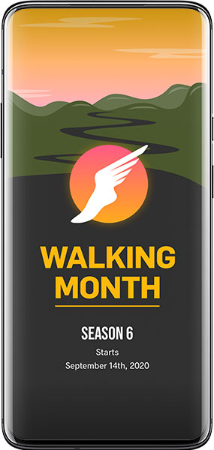
Summary
About Walking Month
How it works
What we have achieved so far
2019: A look back
2020: The cause
Get Involved
Timeline
Companies Challenge

Slide 3
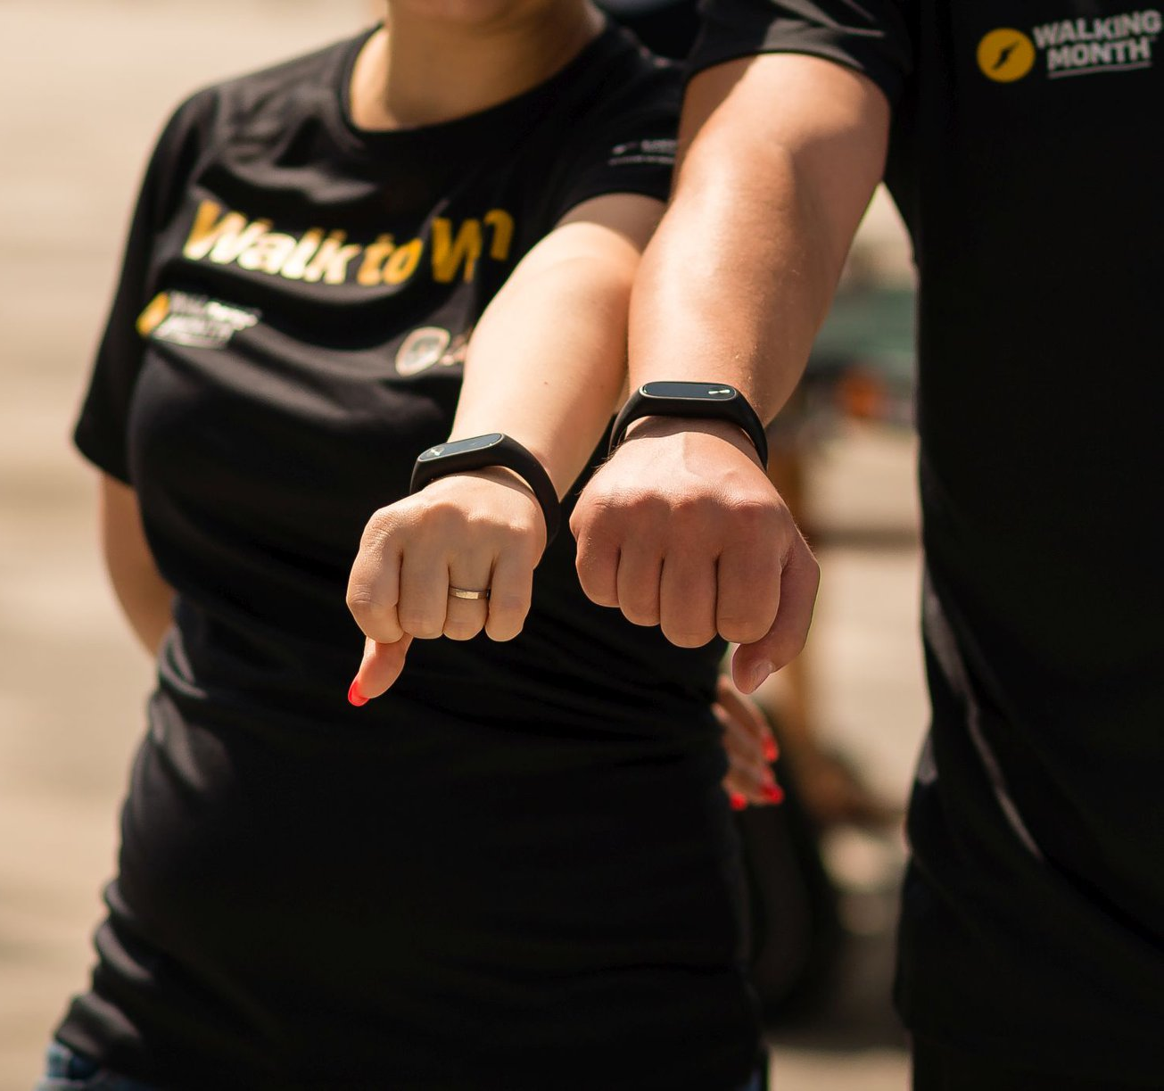
Walk. Get healthy.
Help others.
Walking Month is a charitable competition, which happens annually in Cluj-Napoca. Thousands of people try to make as many steps as possible, for their own health, as well as to raise money for a social cause during one full month.
It started as an internal competition among the Betfair Romania Development employees back in 2010, an initiative aimed to decongest traffic in Cluj-Napoca by promoting walking as a healthier alternative during the busy month of September. Walking Month quickly gained traction and by 2015, it was opened to the entire community of Cluj-Napoca and get a CSR cause associated with it.

Slide 4
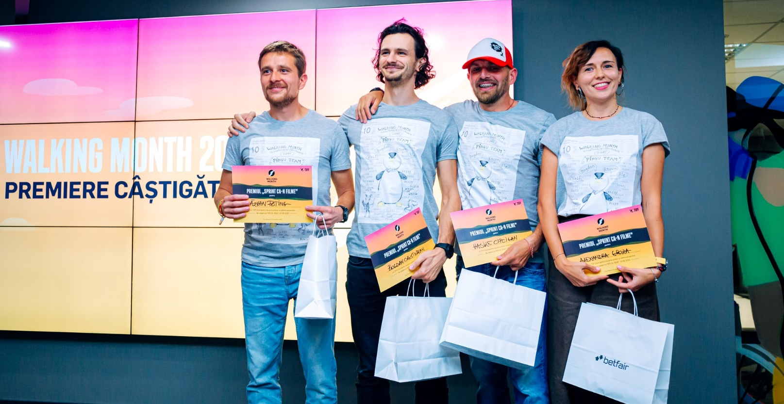
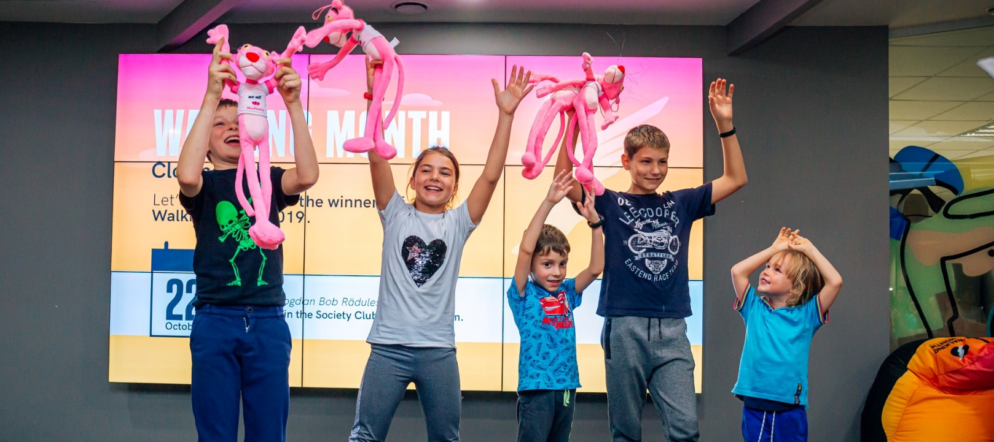
Dream teams wanted
For one month, teams of 4 compete to take as many steps as possible during their daily activities. All the steps are being registered in the Walking Month App. You can either opt for automatically synchronize your phone’s steps tracker with the WM app or have them introduced manually at the end of the day. All the teams have 1 leader who invites the other 3 members to join his/her team and compete together.
Since 2019, two more options have been added to the contest: people can choose if they want to randomly be assigned in a team and teams with 2 or 3 members, as well as individual participation are now allowed.
The Walking Month App is developed by Betfair Romania Development.

Slide 5
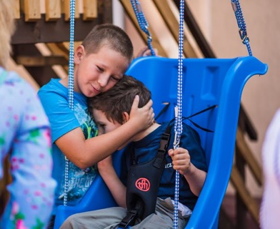
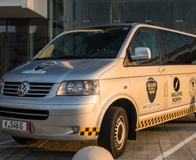
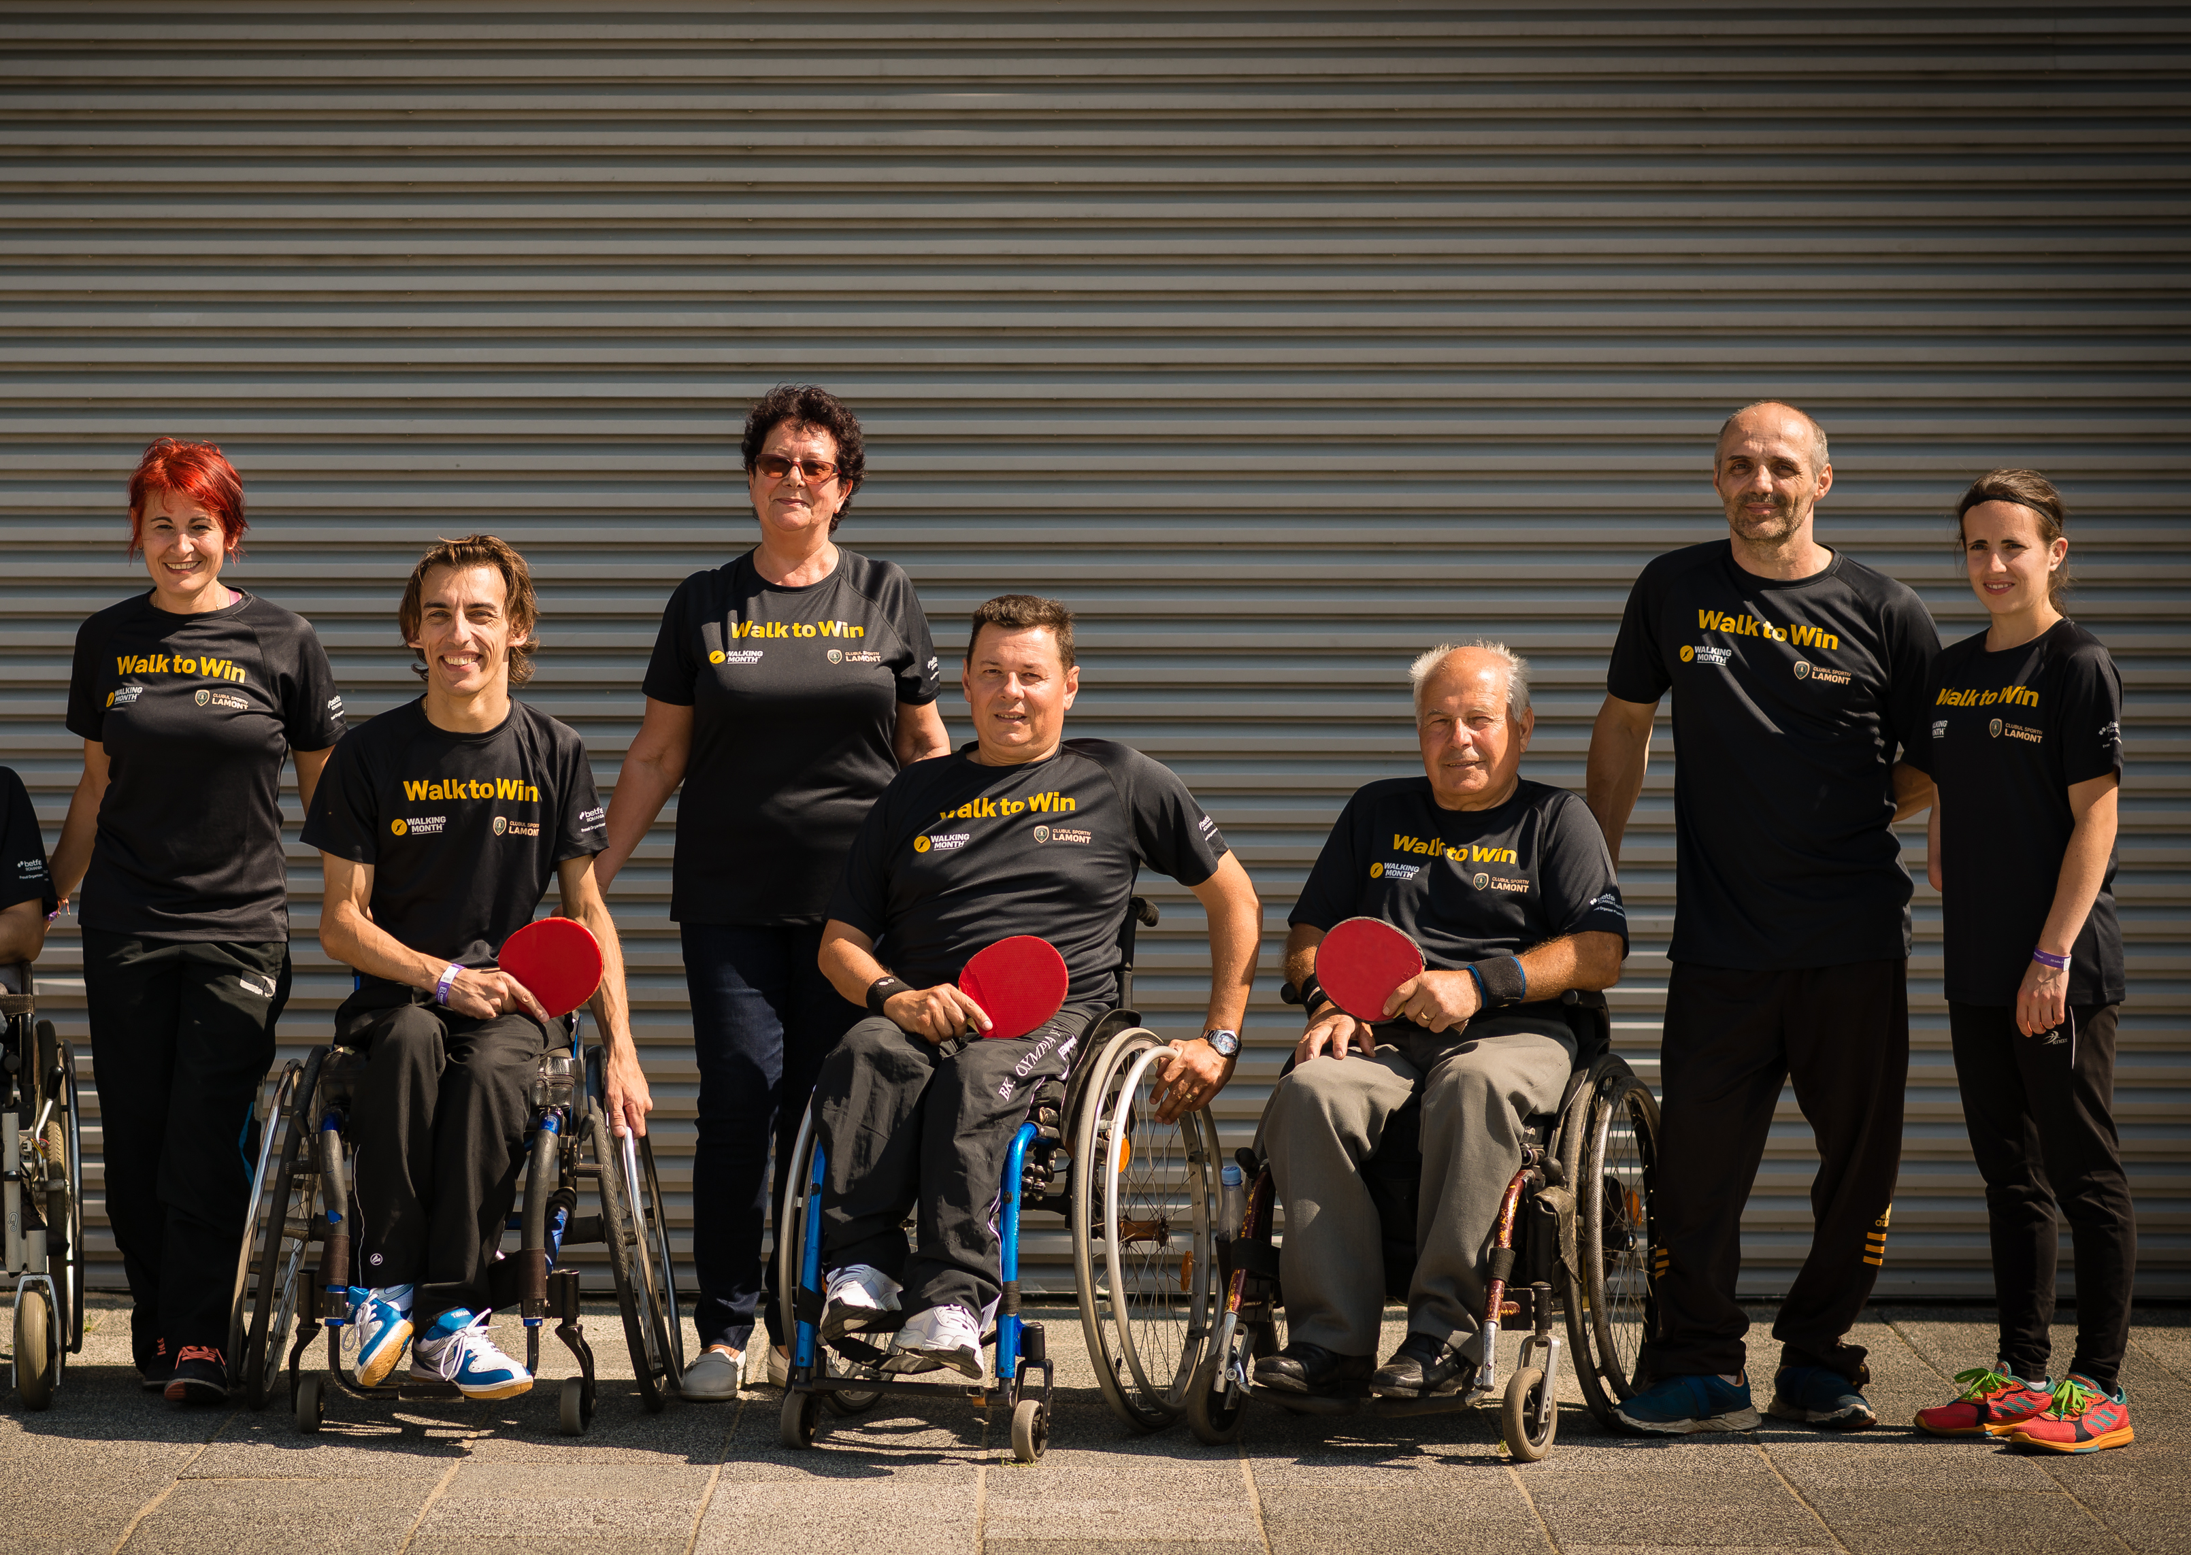

What we have achieved so far
2016
2017
2018
2019
Walk so they can walk: for children
The project covered the costs with the therapy of children with neuromotor disabilities in the care of the Maltese Special Kindergarten in Cluj-Napoca.
Fuel the Beard Mobile, the community taxi
We wanted to ensure fuel and salary costs for Cluj’s only community taxi, for 1 year. What happened is we raised enough funds to buy a second vehicle, and cover costs for both!
Helping Romania’s Paralympic Athletes
The project provided an adequate budget for the club to keep functioning in 2019. It also covered the costs of the qualifying phase for the Tokyo 2020 Paralympic Games.
Transylvania’s first social ambulance
We raised funds to buy the first accredited `social ambulance` in the region: a specially equipped vehicle that will be used by volunteers to provide medical and social services, travelling to isolated communities.

Slide 6
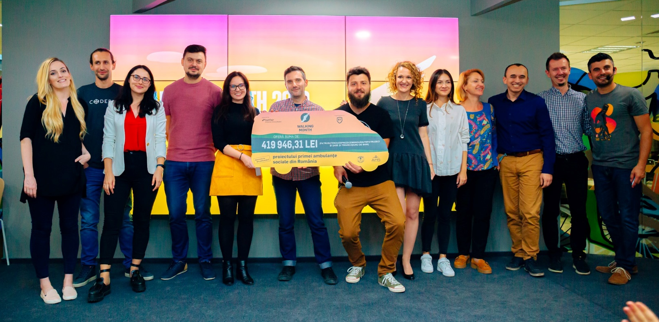
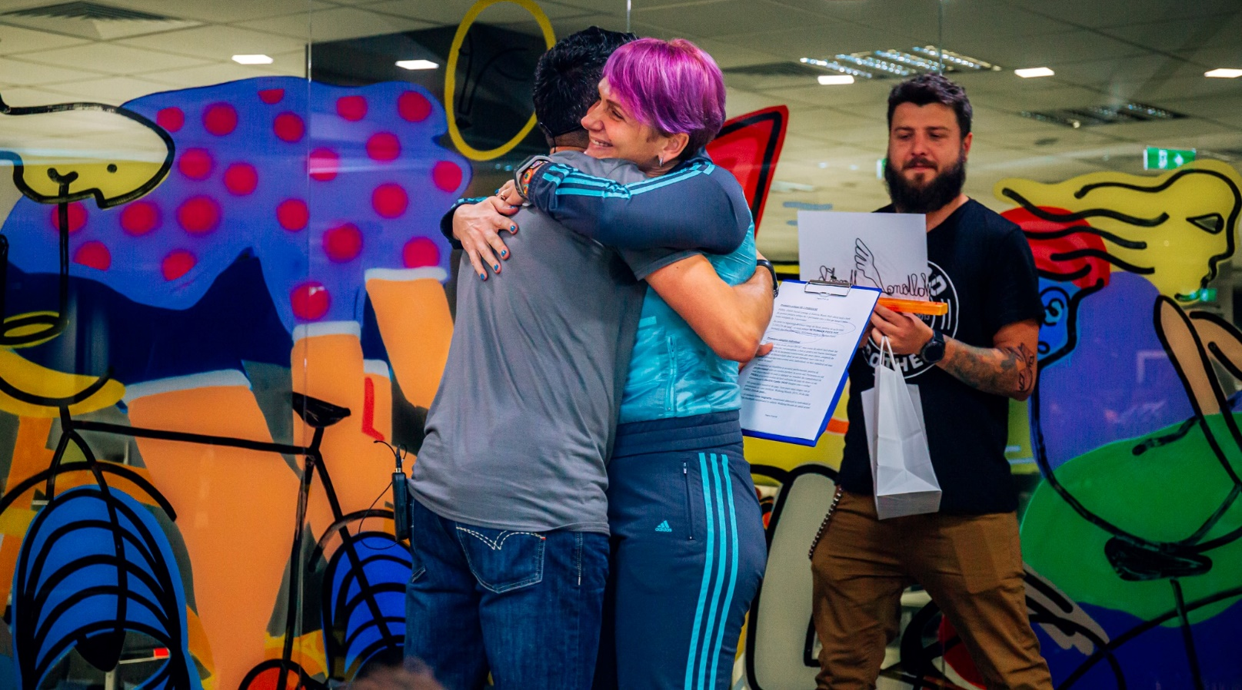
2019: over 3000 people walking for good
The record results of 2019 were made possible by more than 3,100 contestants, who took over 959 millions steps.
Through registration fees and supplementary donations during Walking Month, we’ve raised 419,946 RON, which fully covered the costs of buying a van and equipping it with primary medical care equipment, enabling it to become Transylvania’s first social ambulance: both a medical office with basic services and a mobile social welfare office.
Its purpose is to travel, offer help and support to isolated communities in the region.

Slide 7
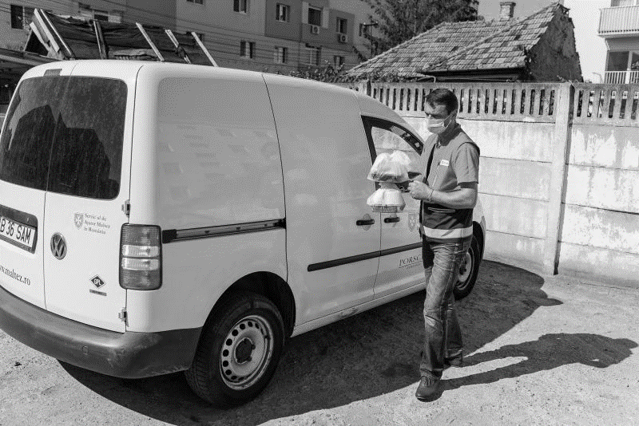
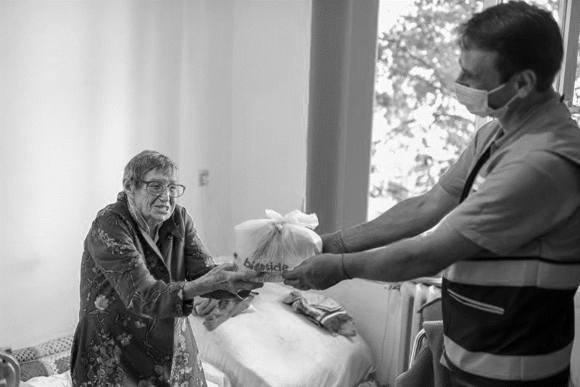
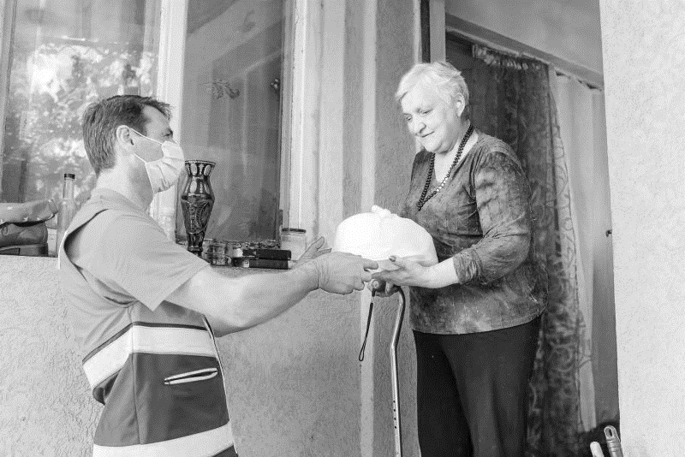

2020: We walk to provide 20.000 meals for the lonely senior citizens in Cluj
For hundreds of seniors in Cluj, isolation is a permanent, imposed lifestyle. With no resources, these senior citizens depend on the „Meal on wheels” program of the Maltese Relief Service in Romania for the certainty of a hot meal every day.
Without this program, some seniors would not even speak to anyone for days. They would just keep living in a city of hundreds of thousands of people, none of whom are thinking about them.

Slide 8
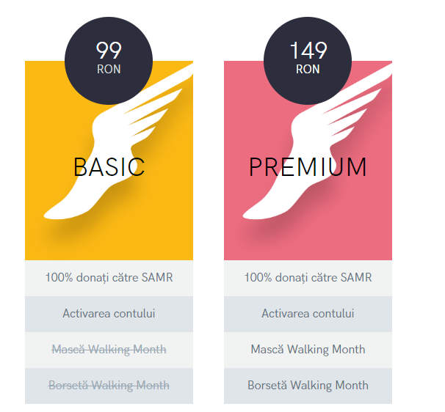
2020: Participation packages
This year, in the context of the logistical challenges imposed by the COVID-19 pandemic, there is no package that includes fitness trackers.
You can participate with your own fitness tracker or track your steps with Google Fit or Apple Health directly on your phone.

Slide 9
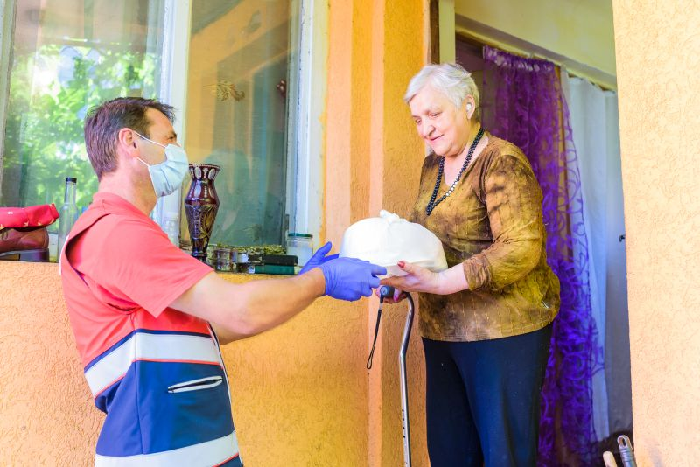
Get involved!
Walking Month is launching a challenge of solidarity: take part in the competition this autumn, and 100% of registration fees will be used to ensure that, at least for one year, 120 seniors in Cluj will receive a daily visit from “Meal on wheels”.

Slide 10

Ready. Steady. Walk!
Registration: 17th August – 11th September
Competition: 14th September – 13th October
Awards to be offered on: 22nd October

Slide 11


Walking Month Companies Challenge
Keep your employees active and connected.

Slide 12
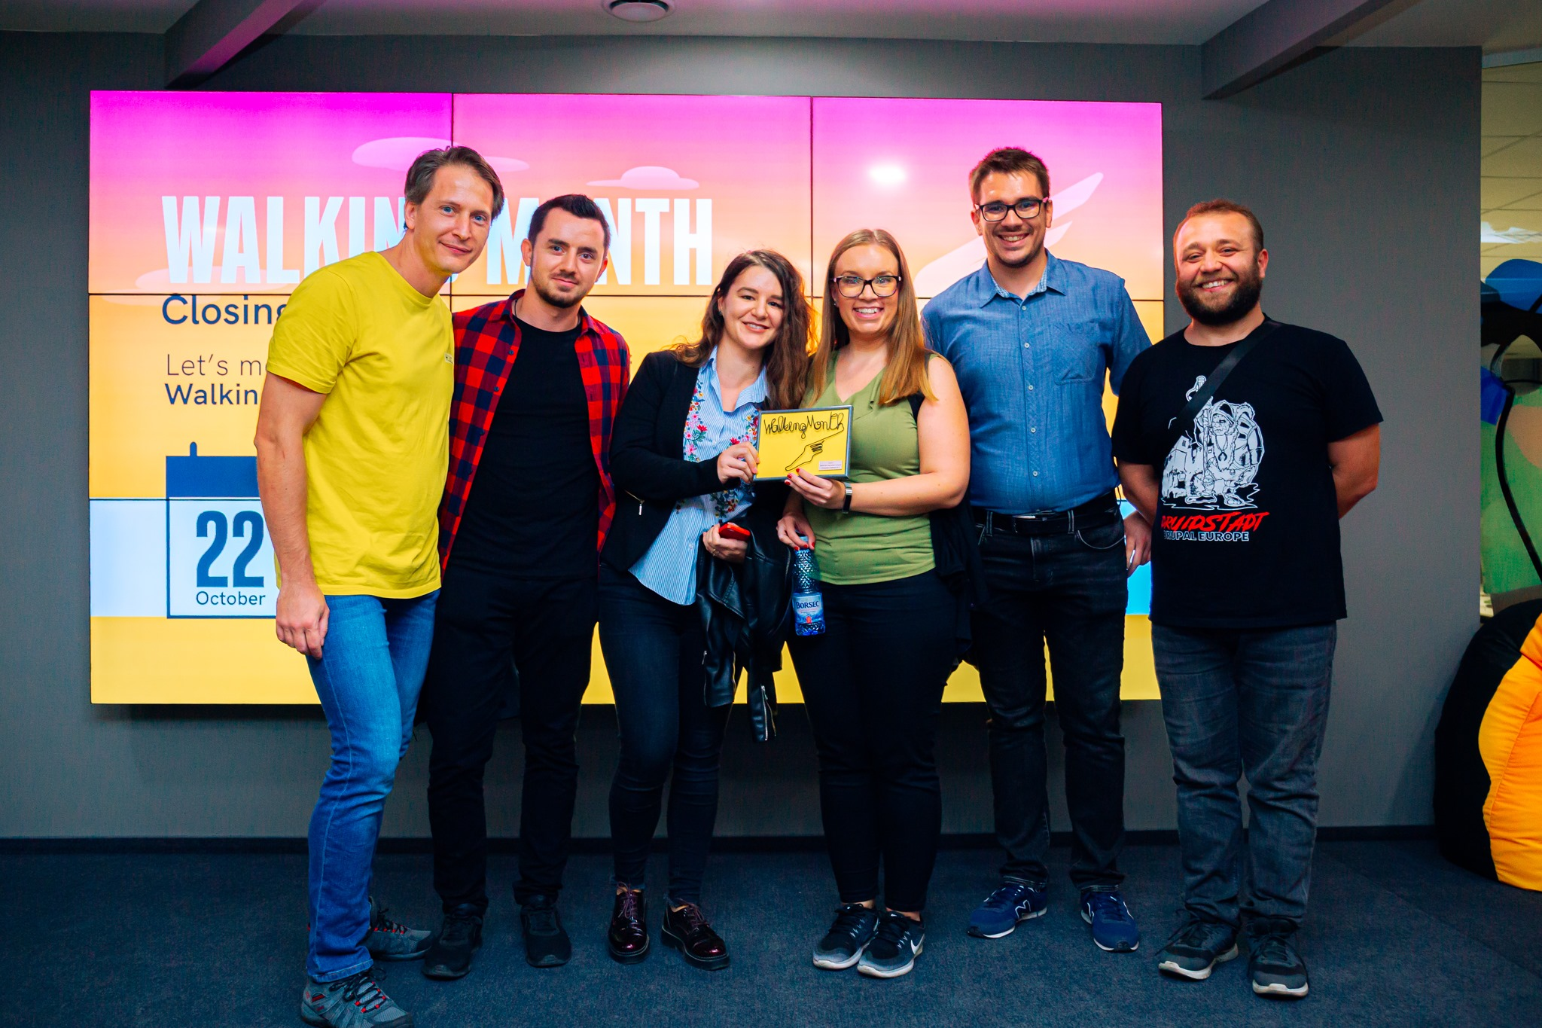
We’re looking for
the most active company
Walking Month is more interesting when friends and colleagues take part together!
Get your people engaged and compete to become the Most Active Company in Cluj. Take part in Walking Month’s Companies Challenge.

Slide 13
Make it a meaningful experience.
Enjoy the benefits.
Position your company as one which encourages a healthy lifestyle for its employees.
Get involved in a project that keeps your employees active even while working from home.
Gain brand exposure by associating your company with the Walking Month local community
Promote Walking Month as a wellbeing program among your employees.
Keep your employees connected while promoting Walking Month as a cross-teams collaboration project
Shortlist the Walking Month cause on your CSR roadmap this year

Slide 14
How can you be part of the #CompaniesChallenge
As a company, you can take part in the #CompaniesChallenge by:
having your employees registered within the competition;
making sure they have completed the Company field in their Walking Month App;
let us know you agree to take part in this and have your name being displayed in public communication about the competition on Walking Month and Betfair Romania Development pages.
Your employees can register themselves individually (and write the company name in their personal profile) or the company can support the participation fees for its employees.The participation fees you decide to pay as a company collectively for your staff will go 100% as a donation to the NGO we support in Walking Month 2020, via a CSR contract.

Slide 15
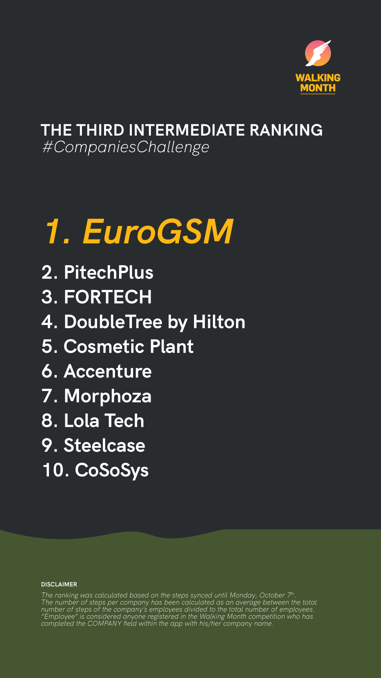
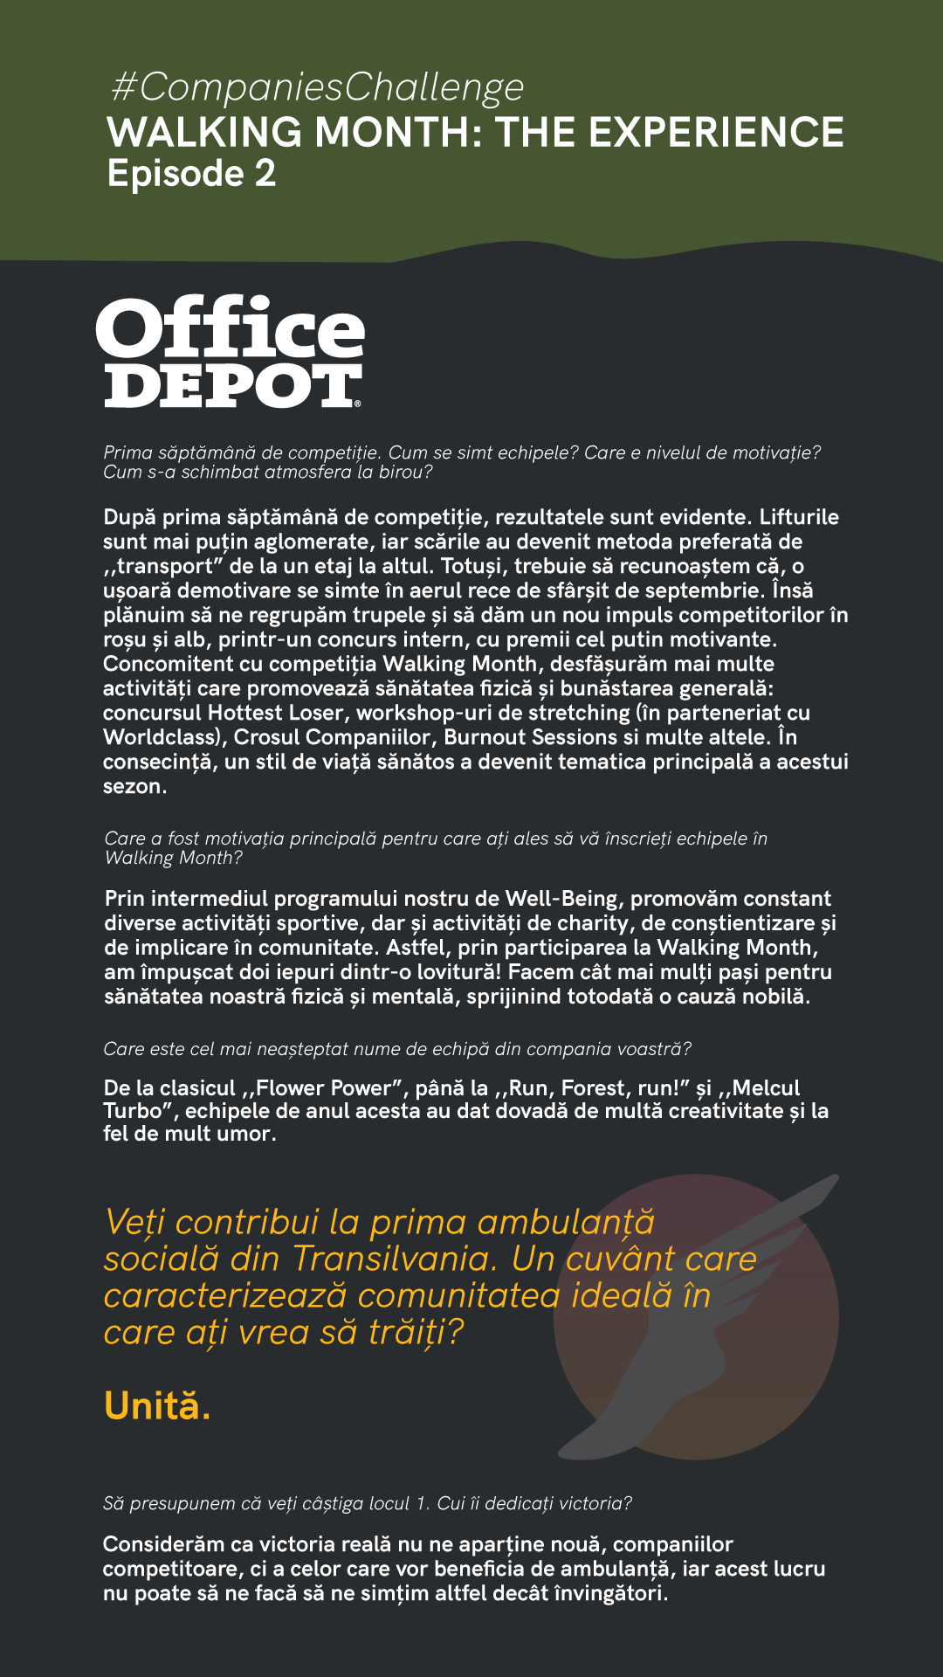
We look for teams that love to walk.
And to compete.
READY
Start by spreading the word about Walking Month in your company via the internal comms channels.
STEADY
As a company, you can do more. Choose to make an extra donation for the Walking Month cause.
Let’s discuss your options and the extra benefits.
WALK
Companies taking part in the #CompaniesChallenge are featured in dedicated posts on our social networks. Rankings are also published weekly.

Slide 16
Talk the talk.
Walk the talk.
Do you want your company to be part of Walking Month 2020?
We’ve got plans for you. Let’s talk.

Slide 17
The people behind
Walking Month is a project initiated by Betfair Romania Development in partnership with Banca Transilvania for the Maltese Relief Service in Romania.

