Slide 1
The Digital & Mobile Travel Solution
Search and reservation online engine for all types of travel products
1

Slide 2
Who is Veltravel?
Romanian Online Travel Agency, with highly performant online search and booking engine, www.veltravel.ro/com
Over 15 years active in tourism and 10 years in online
Concept: one stop shop for all type of travel products, with instant confirmation
Real time access to:
over 560K hotels, 80K apt. and villas
flight tickets for worldwide destinations
dynamic offers flight + hotel
rent-a-car, hotel transfers insurance
charters

Slide 3
What we offer
Over 2.400.000 unique accommodation offers from which we get the best price
Over 12.500 flight destinations, including low cost flight options
Over 25 worldwide providers for accommodations, flight tickets & other services, such as : EXPEDIA, WORLDSPAN, TRAVELFUSION, GTA, GO GLOBAL, RENTALCARS, MONDIAL INSURANCE
Partnership with Expedia – largest worldwide travel company - that offered access to all Expedia functional facilities:
Listing the hotels by the extended location area
Hotel localization, points of interest, facilities, map, comments
TripAdvisor
Site functional both in Romanian and English, with possibility to convert in other European languages
Mobile fully functional

Slide 4
Veltravel: Online Travel Providers and Certifications
Veltravel obtained in the last 10 years numerous certifications, allowing the access to major travel suppliers:
For Flights tickets:
TRAVELPORT (USA), 2007
TRAVELFUSION (UK), low cost flights, 2011
For accommodation:
WORLDSPAN, part of the largest group system specialized in booking and accommodation, 2007
GTA (UK, part of Kuoni) and HOTELS4U (Thomas Cook UK division), top 5 accommodation worldwide, 2008/2009
EUROTOURS , 2011 and Mondial, 2016: for ski areas in Germany and Austria
INTERHOME (SUI): for apartments and villas, 2011
EXPEDIA ( USA ) – largest world wide accommodation system, 2013
GO GLOBAL ( Israel ) – global accommodation system, 2013
HOTELBEDS (TUI, Germany), HOTUSA ( Spain ), HOTELSPRO ( Turkey ), 2016
TRAVELPORT ROOMS AND MORE ( USA ): Accommodation integrator for 8 global booking systems
MELITOURS, ASTRAL HOLIDAYS, for Bulgaria and Greece, 2016

Slide 5
Veltravel: Online Travel Providers and Certifications (cont.)
For Rent-a-car
RENTALCARS ( UK ), global car renting system
For Transfers
A2B (UK), 2016
For insurance
MONDIAL INSURANCE ( Germany ) part of ALLIANZ, 2016
For Activities (tours, attractions, event tickets)
HOTELBEDS ( UK )
For Accomodation
BOOKING.COM starting sept. 2017
For Charters
DERTOUR ( Germany ) by Dec. 2017
For Cruises
MSC Cruises

Slide 6
Our products
Veltravel platform can integrate in a dynamic mode accommodation services, flight tickets, transfers, rent a car, charters, cruises, activities, insurance, other
Flight + accommodation
Flight + accommodation + transfer
Flight + accommodation + rent a car
Flight + charter for exotic destinations provide by major tour operators
Flight + cruise
All above products can have upsell with insurance and activities

Slide 7
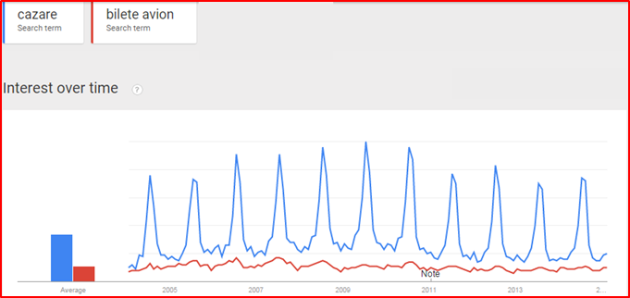
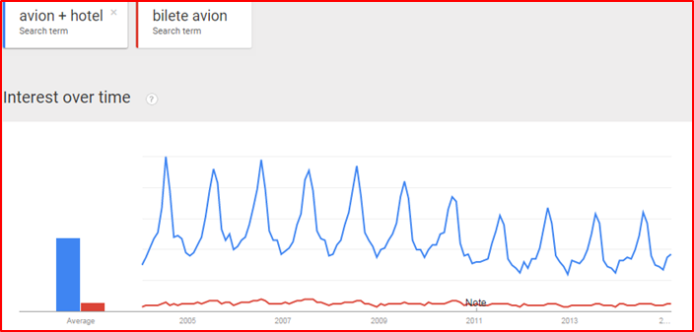
Why are flight + accommodation packages so important?
Online searches for accommodation are 3 times wider than for flight tickets => VELTRAVEL, with a data base of over 640,000 accommodation units is the main source of information and buying, alongside Booking.com
Searches for flight tickets and hotel combinations are 7 times wider than flight tickets => VELTRAVEL is the main integrated flight and accommodation services provider

Slide 8
Market and competition
Market
Tourism is the only sector with continuous growth in the last few decades, with marginal / temporary decreases in pick economic crisis
Out of the top 100 destinations, over 85% show increases in the last 3 years. Most of temporary decreases are outside Europe or other main interest destinations
Online tourism sales increase significantly faster than traditional tourism agencies
Mobile is already higher than desktop in search and increasing significantly faster in acquisition
Online payments have double digit growth
Competition in Europe:
Booking.com => only for accommodation; cannot offer flight + hotel packages
Momondo & others => metasearch, cannot sell directly

Slide 9
Veltravel competitive advantages
Unique reservation system that offers dynamic Flight tickets + Accommodation packages through a single dynamic search in real time
“One stop shop” concept of integrated services for travel and tourism, for leisure and business segment.
Dynamic search offers by interests - beach, ski, city break
Best price for tourist products by analyzing the best offer from several bidders
Online payments
Partnership with an international brand – Expedia.com
Own XML solution integration with multiple partners for accommodation and flights
Modular architecture allowing further development and integration of new products / partners
Mobile version

Slide 10
Our strategy
Continue our development as technology company in the area of online travel
Exploit the modular architecture structure, meaning:
Enter new geographies, directly or through partnerships
Establish partnerships with major companies from other sectors, with interest in online business
Add new products, new suppliers
Continue growing the business in Romania

Slide 11
Partnership models with large companies interested in online business 1. Partnership with a major tour operator from a large European country 2. Partnership with a large European multinational company

Slide 12
Why Online tourism as a new business line?
The online travel reservation systems are dominating over traditional travel agencies
Clients are chasing the best offers but looking also for safety in online payment
Our answer
Combines the benefits of Online travel site and Secure online payment
VELTRAVEL.COM
New business stream for an established tour operator, addressed to gain new clients
Generates more transactions due to extensive offer on the same platform

Slide 13
New Business Line – Online travel products
PARTNER
Corporate Travel Solutions
New Income Stream
Internal Travel Portal for Employees
Thousands of Travel Offers Available Worldwide
Real Time Reporting & Sales
Integrated & Ready to Use Travel Solution
Modular architecture to incorporate other products
1

Slide 14
Business Models Generated by Veltravel.com
New travel product for PARTNER targeted through sales and marketing campaigns – See revenue model
Internal travel portal for PARTNER employees –best services at the best costs – Discount on standard Veltravel offer
Business travel partner – corporate platform & commercial terms for business travel – Best cost vs. services
Special offers for PARTNER client portfolio – Discounts/loyalty
4

Slide 15
The Digital & Mobile Travel Solution
1

