Slide 1



17th – 20th of March 2016
Be part of it!

Slide 2

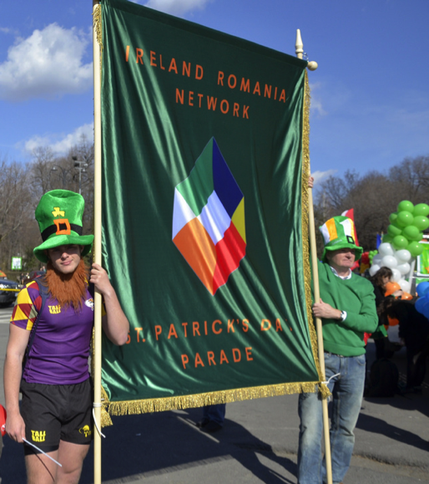
History
Every year on March 17th the Irish and the Irish-at-heart across the globe celebrate St. Patrick’s Day.
This holiday particularly remembers St Patrick, Ireland’s patron saint, who brought Christianity to Ireland in the fifth century.
What began as a feast day for the patron saint of Ireland has become a global festival celebrating Irish culture with parades, dancing, food and drink and a whole lot of green.

Slide 3
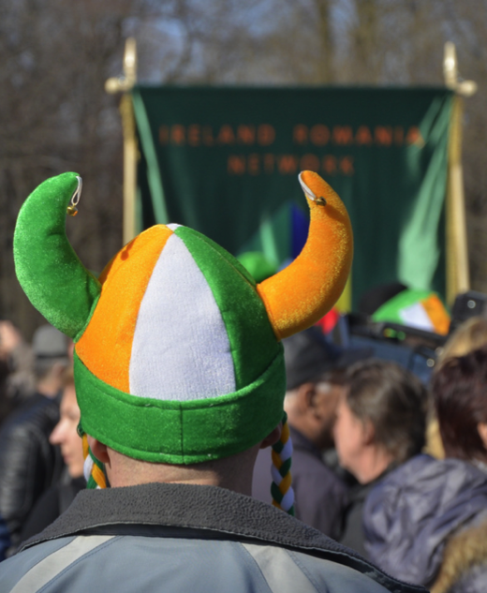
Previous Years
In previous years, over 10,000 people have gathered in Bucharest for the St Patrick’s Day Parade. This huge Parade has traditionally started at Bulevardul Kiseleff and ended in front of the Ateneul Roman.
Led by a champion Pipe and Drum band from Co. Donegal in Ireland a procession of colourful floats decorated in the colours of Ireland and Romania paraded on Bucharest’s streets joined by 150 Irish, Romanian and Bulgarian dancers and singers.
During the parade, members of the Arlechinii Rugby Team organised a flashmob, that all the participants could join.
More than 40 cheerleaders accompanied the parade and held a brief show during the ceremony.

Slide 4
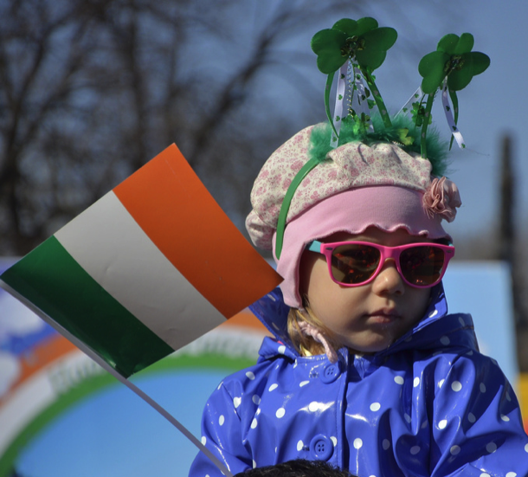
Previous Years
Music was performed by over 60 pipers from Ireland, Romania and Bulgaria.
Children who joined the parade received balloons and flags and their faces were painted by an artist.
Also, several Irish dogs, trained to help people with sight deficiencies, were present at the festivity, dressed in green capes.
The Parade ended at George Enescu square where spectators were treated to a show of traditional Irish dancing
Afterwards, participants were invited to enjoy a Black Beer Tasting in Valter Maracineanu Square

Slide 5
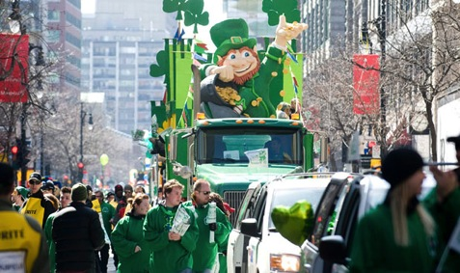
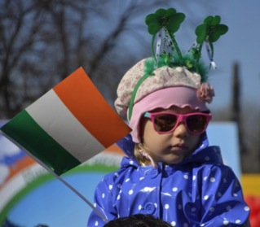
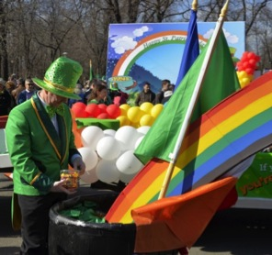
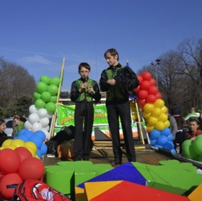
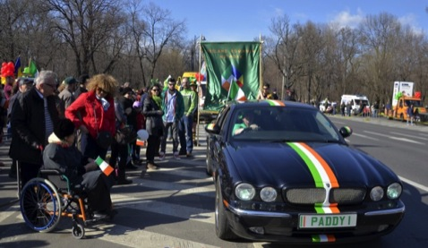
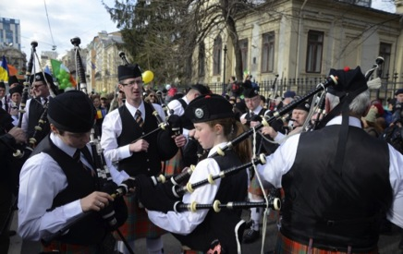
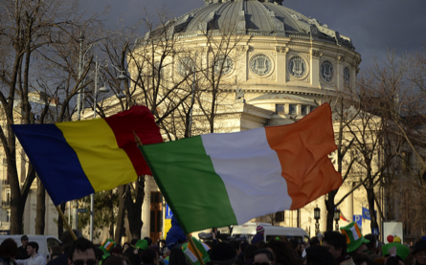
In 2016 we will have a series of events over 4 days finishing with the biggest parade ever!

Slide 6

2016 St. Patrick’s Days Agenda
Thursday 17th – Embassy Reception by invitation only, location tbc
Friday 18th – St. Patrick’s Day Ball 2016, Intercontinental Hotel, 19.30
Saturday 19th – Irish Pipe & drum band rehearsal, Herastrau park 12.00
Saturday 19th – Grand Finale of the 6 Nations Rugby tournament 2016 Champions Sports Bar, Marriott, 15:30 – late
Sunday 20th – Main St. Patrick’s Day Parade, Muzeul Taranului, Kiseleff – Calea Victoriei – Ateneul Roman, 15:00 - 17:00

Slide 7
Media Coverage
The media campaign for the previous St. Patrick's Day Parade started on 25th of February with a press release that generated around 40 articles within the national and local media.
March 12th - another press release generated a further 30 articles in the most important publications at both local and national level.
Over the St. Patrick’s Day weekend 16th -17th of March, the Bucharest Parade was reported 70 times at national level and about 10 times at international level, reaching over 24 million people.
Over 10 news stations have covered the parade and broadcasted several news items about it generating a cumulative audience (including repeat viewers) of about 16 million people.

Slide 8
Media Coverage
The Parade attracted significant international attention with syndicated photos and stories being picked up in some online international media sources like : The Irish Times, USA Today, NY Post etc.
The main TV stations that covered the parade were: Pro TV, Antena Group (1, 2, 3), Realitatea, Romania TV, Kanal D, Digi 24, TVR and Prima TV.
There were also several report on the national Radio stations: Radio Europa FM, Radio Romania Actualitati and Radio Romania Cultural.

Slide 9
Media Coverage
http://stirileprotv.ro/stiri/social/sfantul-lor-distractia-noastra-romanii-petrec-in-stil-irlandez-cu-mii-de-litri-de-bere-si-parade-de-saint-patrick.html
http://www.b1.ro/stiri/eveniment/saint-patrick-day-celebrata-in-centrul-bucure-tiului-video-78212.html
http://stiri.tvr.ro/bucuresti-mii-de-oameni-la-parada-de-ziua-sfantului-patrick-patronul-irlandei_41746.html
http://www.romanialibera.ro/actualitate/fapt-divers/parada-st--patrick-s-day-din-bucuresti--mii-de-persoane-au-participat-cu-stegulete-si-baloane-329256
http://www.click.ro/news/national/hai-la-parada-de-sf-patrick
http://www.fotostefan.ro/versiunea-romaneasca-a-paradei-de-sfantul-patrick-foto-si-video/

Slide 10
Sponsorship Packages

Slide 11
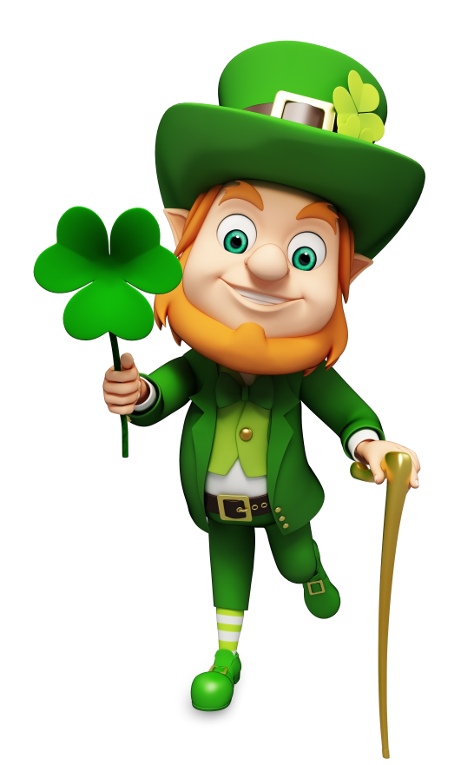
Join us for an amazing experience!
This Parade is only possible with the highly valued contribution of our organisers and sponsors. Together, as partners, we want to give the entire community a really memorable experience, filled with colour and fun. The atmosphere of goodwill and strong spirit of co-operation between nations makes this festival certainly one to remember!
If you would like to be involved as a sponsor of this fantastic event, please contact our coordinators and we’ll find the best way to add value to this experience!

Slide 12
Reasons to join us:
Great opportunity to increase brand awareness
The chance to meet & interact with interesting people
The perfect event to showcase your brands
Great source of content for your online communication channel
A media coverage that will ensure a larger audience will hear about your involvement
The perfect chance to have an amazing time!

Slide 13
Sponsorship Packages | GOLD | SILVER | BRONZE | CORPORATE TABLE | PARADE FLOAT | BALL TICKETS
 | 4000 Euro | 2500 Euro | Products/ Services | 1500 Euro | 250 Euro | 100 Euro
Float at parade | a | (a) |  |  | a
VIP Table (10 pax) for St. Patrick’s Day Ball (prime spot, logo on table, bottle of Jameson special reserve) | a | a |  | a
Individual Ball tickets |  |  |  |  |  | a
Embassy Reception tickets | 6 | 4 | 2
Rugby 6 Nations tickets event in Champions | 6 | 4 | 2
Logos on all media / specific mention at ball | a | a | a
Product sponsor / Services sponsor | (a) | (a) | a
Presence as official sponsor for Bucharest Feis 2016 Romania’s 1st international Irish dance competition | a

Slide 14


Confirmed partners:

Slide 15

Contact Info:
Oana Berbecariu
Phone: +40374470382.
E-mail: oberbecariu@nobeloil.com
Tiarnan O hAimhirgin
Phone: +40731999015
E-mail: tiarnan.o_haimhirgin@ro.sabmiller.com

